Slide 1
Tutorial 2

Slide 2
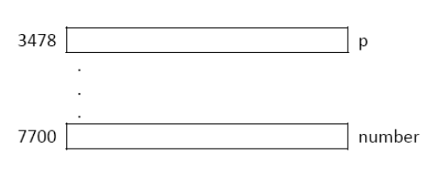
P. 1-1
int number;
int *p;
Operations:
p=100; number = 8;
100
Question?
number, &number, p, &p, *p
8
100
????
Notes:
Semantic segmentation: detect and classify

Slide 3
P. 1-2
int number;
int *p;
Operations:
number = p;
100
Question?
number, &number, p, &p, *p
100
8
100
????
Notes:
Semantic segmentation: detect and classify

Slide 4
P. 1-3
int number;
int *p;
Operations:
p=&number;
7700
100
Question?
number, &number, p, &p, *p
100
100
????
Notes:
Semantic segmentation: detect and classify

Slide 5
P. 1-4
int number;
int *p;
Operations:
*p=10;
7700
Question?
number, &number, p, &p, *p
10
100
Notes:
Semantic segmentation: detect and classify

Slide 6
P. 1-5
int number;
int *p;
Operations:
number = &p;
7700
Question?
number, &number, p, &p, *p
3478
10
Notes:
Semantic segmentation: detect and classify

Slide 7
P. 1-6
int number;
int *p;
Operations:
p = &p;
3478
7700
Question?
number, &number, p, &p, *p
3478
Notes:
Semantic segmentation: detect and classify

Slide 8
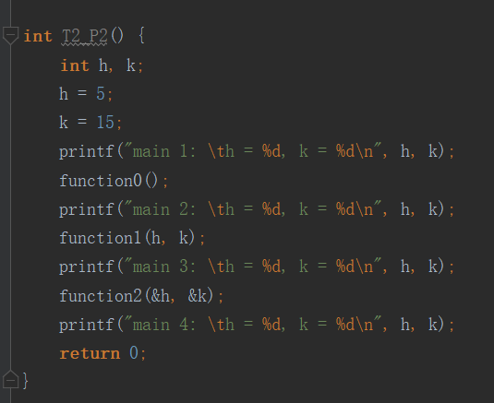
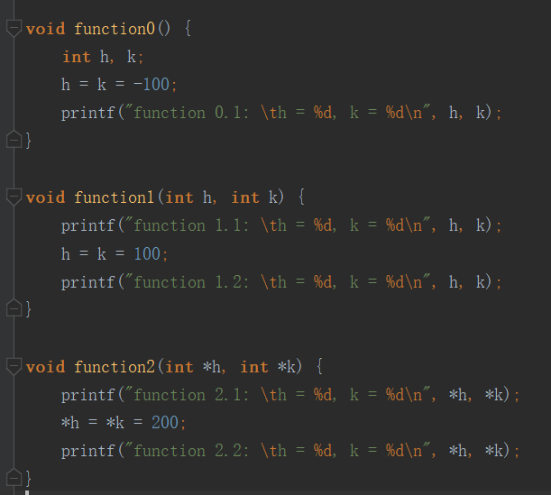
P. 2
5, 15
-100, -100
5, 15
5, 15
|| 100, 100
5, 15
5, 15
|| 200, 200
200, 200
Notes:
Semantic segmentation: detect and classify

Slide 9

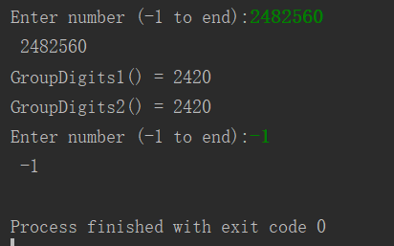
P. 3
Write a function groupDigits() which extracts the digits, that are less than 5 from the non‐negative number n, and combines the digits sequentially into a new number. If there is no digit that is less than
5, the new number will be set as –1. The new number is then returned to the calling method. For
example, if n = 123456, then the value 1234; and if n = 567, then –1 is returned. Write the function in
two versions: function groupDigits1() returns the result, while groupDigits2() passes the result back
through the second parameter, nd. You should not use arrays in this problem. The function prototypes
are given as follows:
Notes:
Semantic segmentation: detect and classify

Slide 10
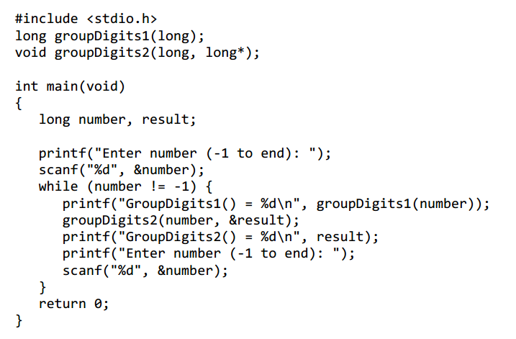
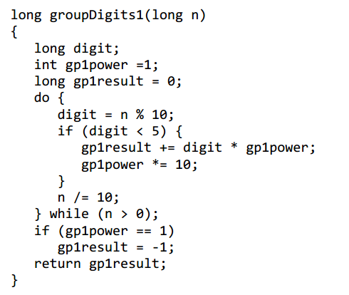
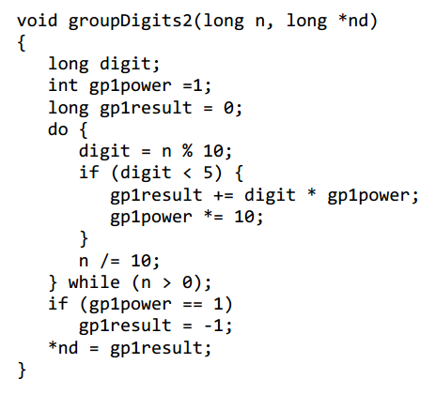
P. 3
Notes:
Semantic segmentation: detect and classify

